Slide 1
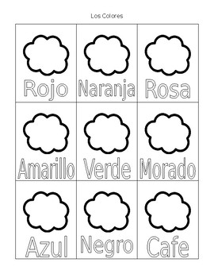
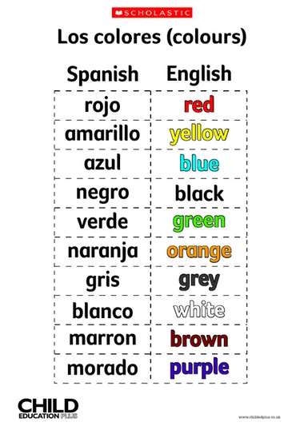
Practica Los Colores After coloring and tracing the colors, you can play a game following the next directions: 1. Collect different little things around the house 2. Label paper plates (or any other containers you have at home) with these colors in Spanish 3. Sort all the things you collected in the containers 4. If you are a third grader or older, you can time this activity and challenge your family members to see who can do it faster!. Have fun!!!

